Slide 1
Segmentation - Split and Merge

Slide 2
Objectives
Learn about K-means and mixtures of Gaussians.
Learn the principles of Mean shift segmentation.
Their applications in image processing.

Slide 3
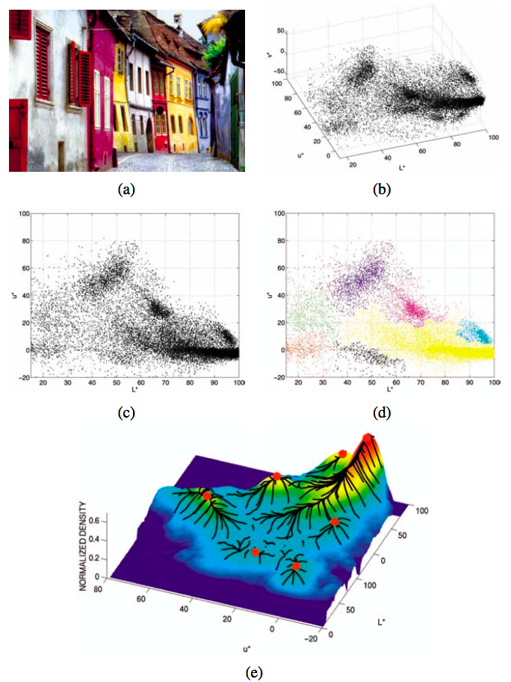

Color Image Segmentaion
How to segment this image based on color alone?
How to finding these clusters?
How many obvious clusters do you see?
Notes:
Mean-shift image segmentation (Comaniciu and Meer 2002) ⃝c 2002 IEEE: (a) input color image; (b) pixels plotted in L*u*v* space; (c) L*u* space distribution; (d) clustered results after 159 mean-shift procedures; (e) corresponding trajectories with peaks marked as red dots.

Slide 4
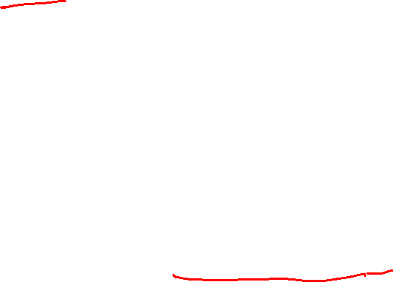
K-means for Segmentation
K Means is a clustering algorithm.
It is used to identify different classes or clusters in the given data based on how similar the data is.
Data points in the same group are more similar to other data points in that same group than those in other groups.
K represents the number of clusters.
The main idea of performing the following process is to find those areas of pixels that share the same color hue parameter value.

Slide 5
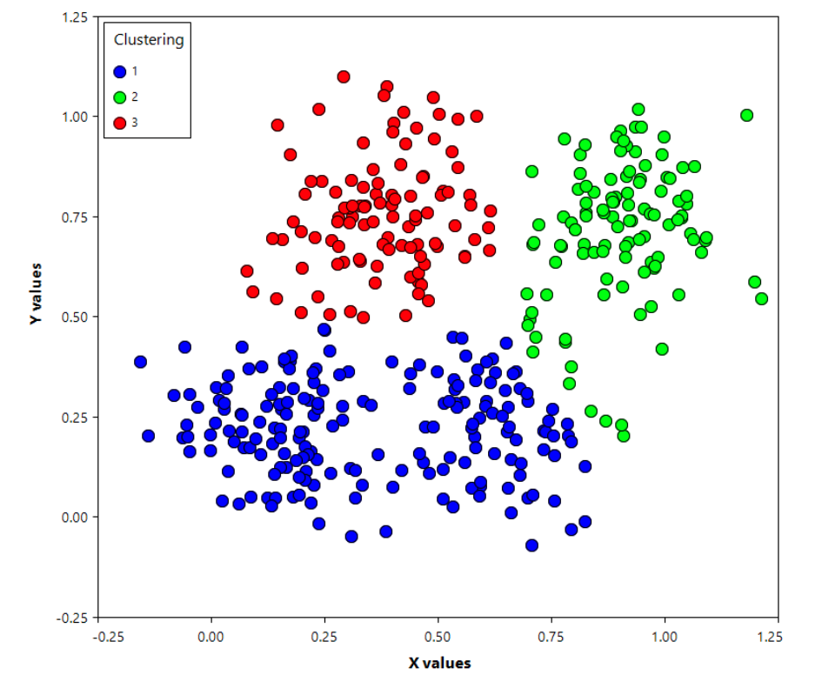
K-means for Segmentation

Slide 6
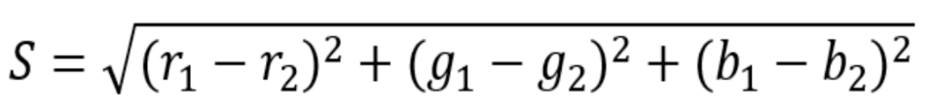

K-means for Segmentation
Guess K centroids positions, a centroid for each results cluster
Assign each observation to the group that has the closest centroid
When all observations have been assigned, recalculate the positions of the K centroids
Repeat Steps 2 and 3 until either the centroid position or the observation assignments no longer move.
→ the magnitude of similarity value between two 3D-vectors of colors (R; G; B):

Slide 7
K-means for Segmentation
Notes:
Visual Representation of K-Means Clustering: Starting with 4 leftmost points.

Slide 8
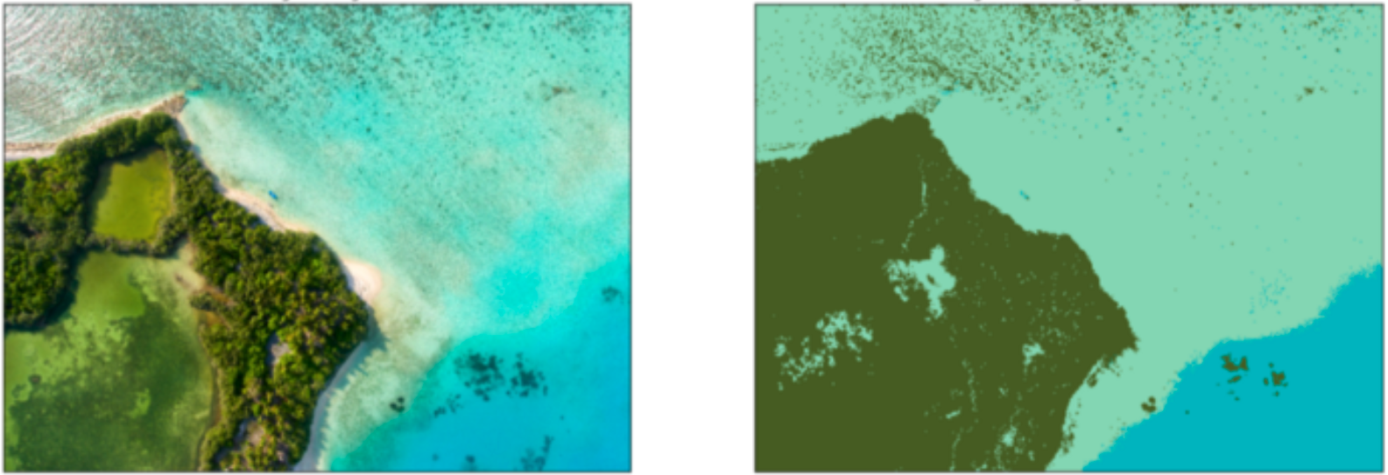
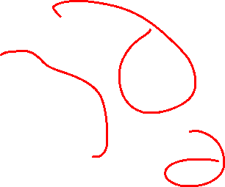
K-means for Segmentation
K=3

Slide 9
Gaussian Mixture Model
Gaussian Mixture Models (GMMs) assume that there are a certain number of Gaussian distributions, and each of these distributions represents a cluster. Hence, a Gaussian Mixture Model tends to group the data points belonging to a single distribution together.
"Gaussian Mixture Model" models each cluster to a Gaussian distribution with a specific mean and variance.
Gaussian Mixture Models are probabilistic models and use the soft clustering approach for distributing the points in different clusters.

Slide 10
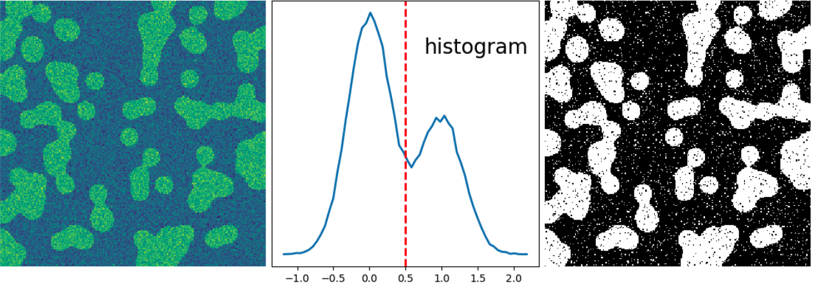
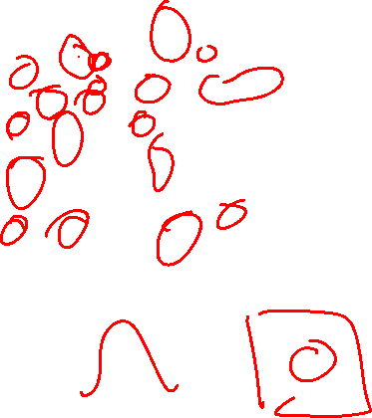
Gaussian Mixture Model

Slide 11
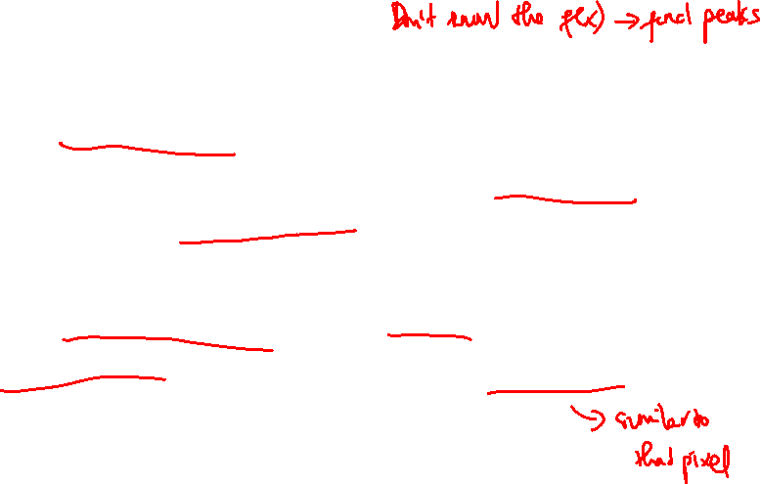
Mean shift
Mean shift implicitly models this distribution using a smooth continuous non-parametric model.
The key to mean shift is a technique for efficiently finding peaks in this high-dimensional data distribution without ever computing the complete function explicitly
The idea is replaces each pixel with the mean of the pixels in a range neighborhood and whose value is within a distance d.

Slide 12
Mean shift Algorithm
Choose kernel and bandwidth
For each point:
a: Center a window on that point
b: Compute the mean of the data in the search window
c: Center the search window at the new mean location
d: Repeat (b,c) until convergence
Assign points that lead to nearby modes to the same cluster

Slide 13
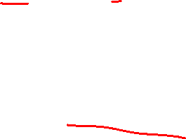
Mean shift Segmentation
Compute features for each pixel(color, gradients, texture, etc.)
Set kernel size for features Kf and position Ks
Initialize windows at individual pixel locations
Perform mean shift for each window until convergence
Merge windows that are within the width of Kf and Ks

Slide 14
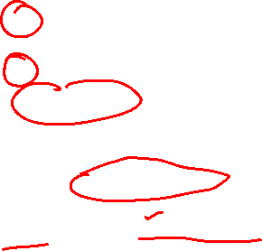
Mean shift Segmentation
Advantage
Good general-practice segmentation
Flexible in number and shape of regions
Robust to outliers
Disadvantage
Have to choose kernel size in advance
Not well suited for high-dimensional features

Slide 15
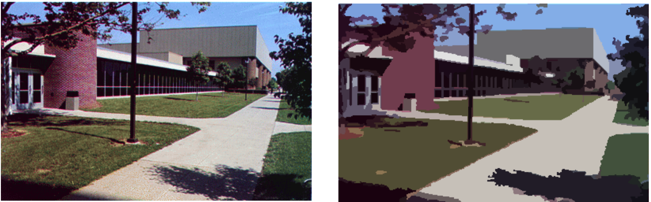
Mean shift Segmentation

Slide 16
Summary
Learn about K-means and mixtures of Gaussians.
Learn the principles of Mean shift segmentation.
Their applications in image processing.

